Slide 1
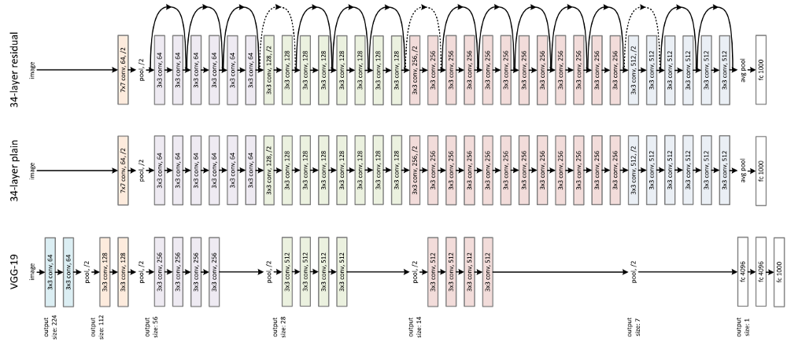
Deep neural networks
Learning decreases as a layer is added, because the error is attenuated each time it flows through a layer

Slide 2
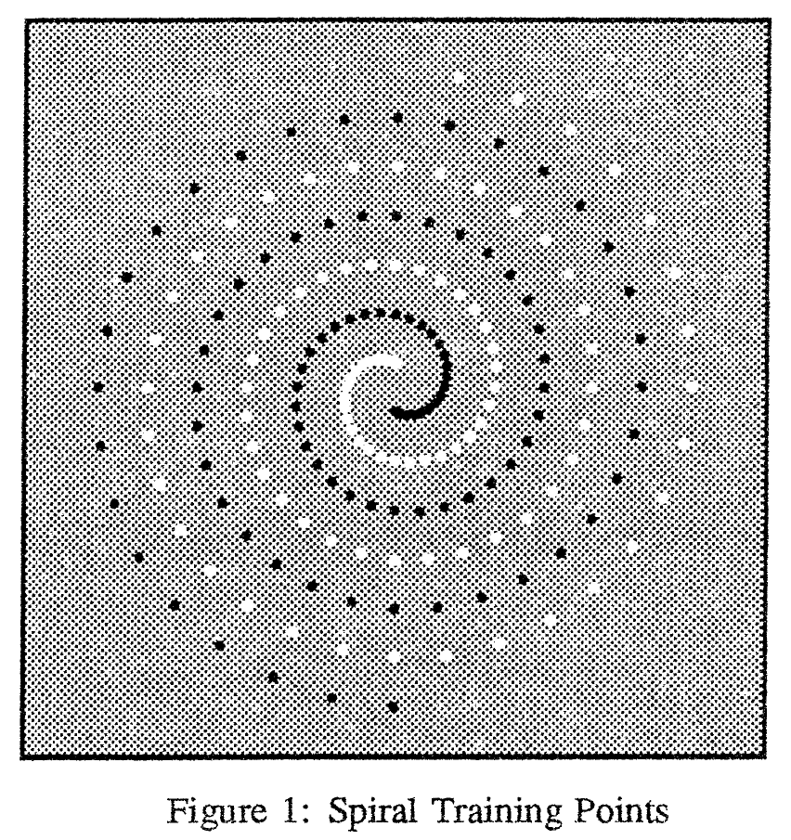
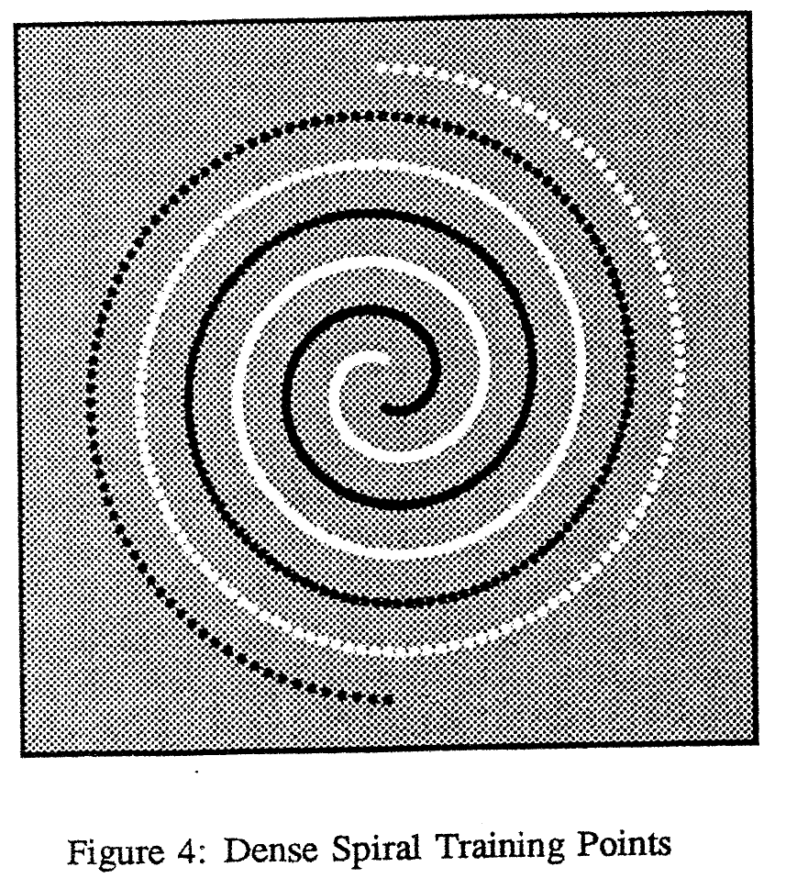
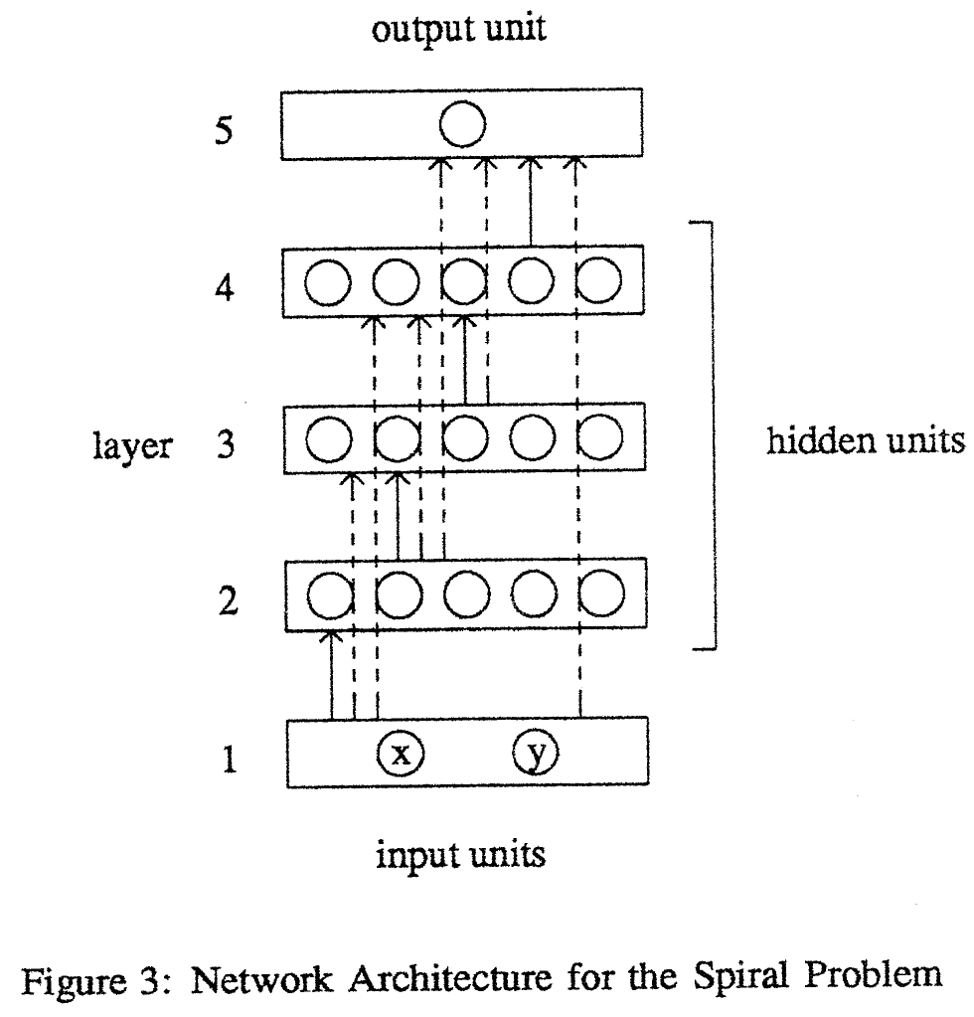
Learning shutdown an order of magnitude as a layer is added to a network. This is because the error signal is
attenuated each time it flows through a layer, and learning progress is limited. To avoid this problem, short-cut
Connections are used to provide direct information pathways to all parts of the network.
Learning to Tell Two Spirals Apart, K.J. Lang, and M.J. Witbrok, Procc. Connectionist Models Summer School CA, 1969

Slide 3
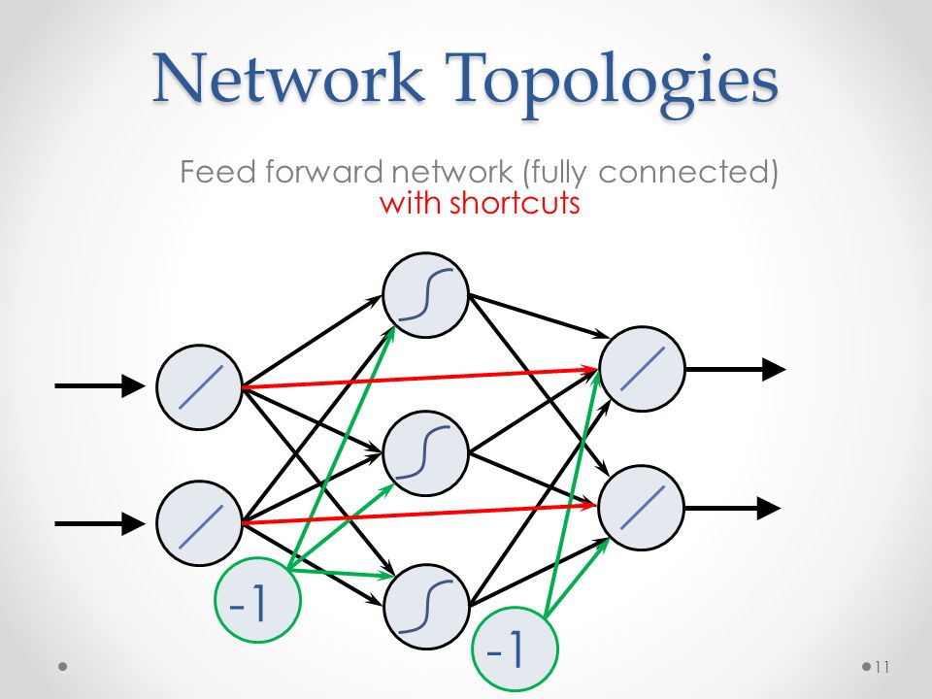
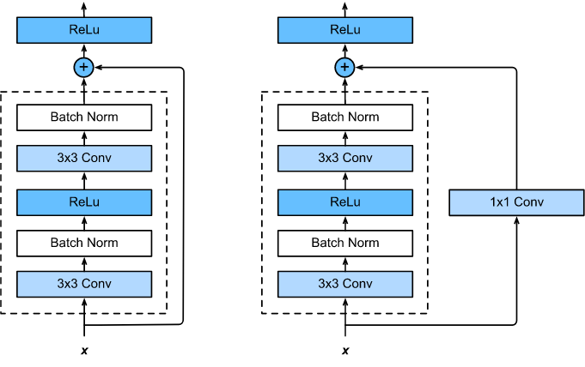
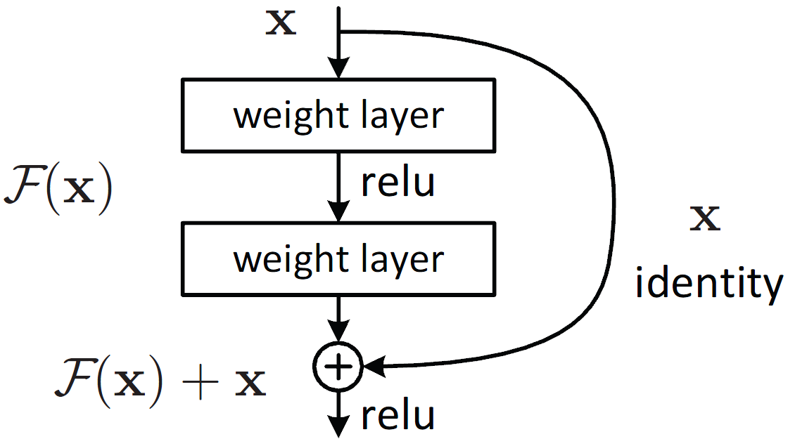
Error is Attenuated each
time it flows through a layer
When deeper networks are able to start converging, a
degradation problem has been exposed:
with the network depth increasing, accuracy gets saturated and then degrades rapidly. Unexpectedly, such degradation is not caused by overfitting.
Residual Learning: a building block

Slide 4
ResNet

Slide 5
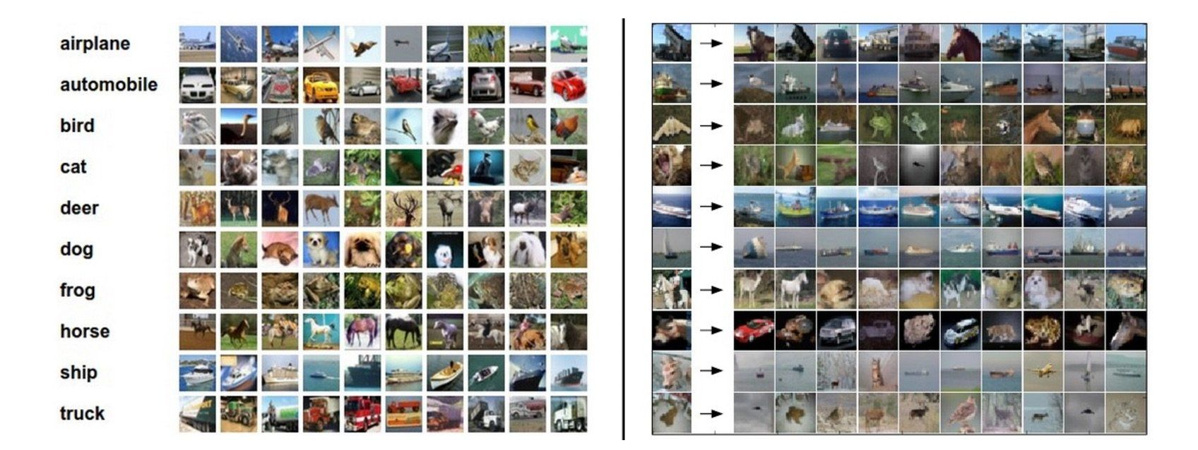
CIFAR-10

Slide 6
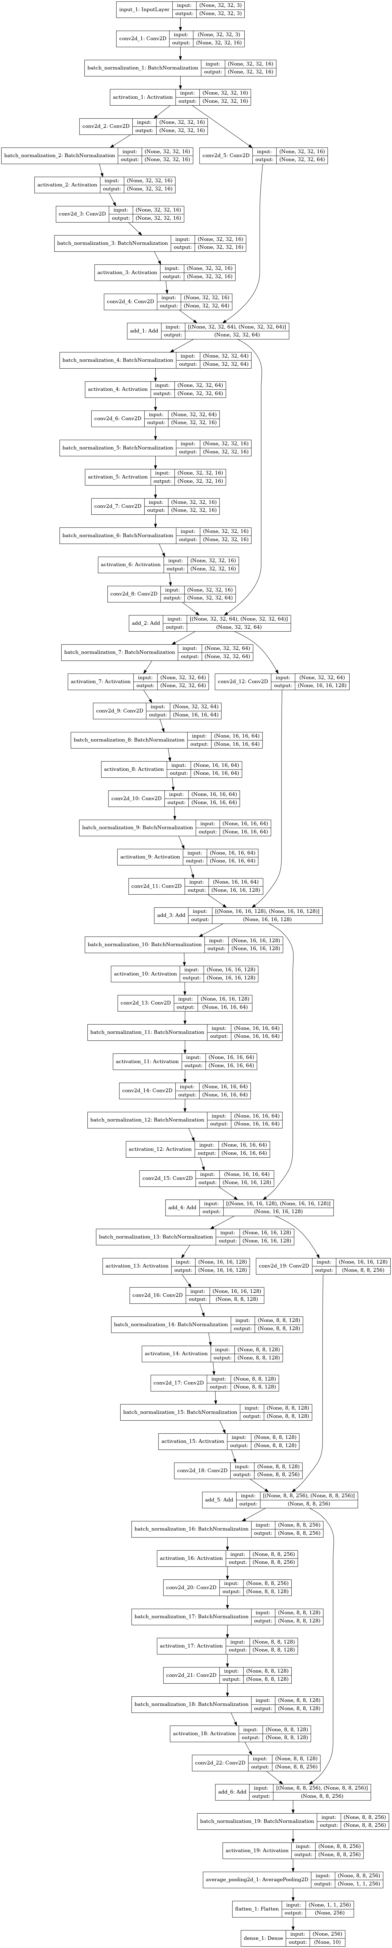

Slide 7
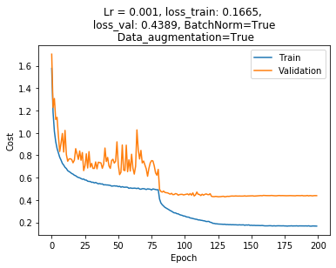
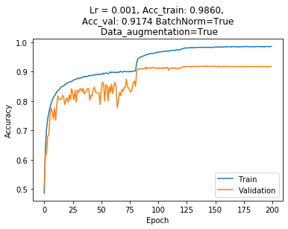
ResNet20, Model version 1

Slide 8
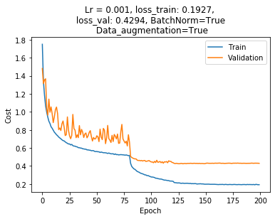
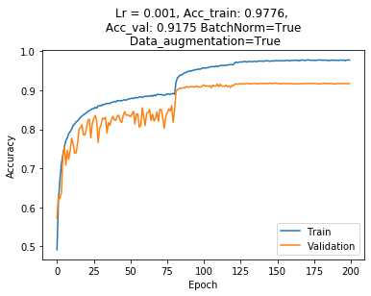
ResNet20, Model version 2

Slide 9
Some other applications
Predicting dynamical system evolution with residual neural networks
A novel ResNet-based model structure and its applications in machine health monitoring
Land-Use Detection Using Residual Convolutional Neural Network
Data augmentation using synthetic data for time series classification with deep residual networks

Slide 10
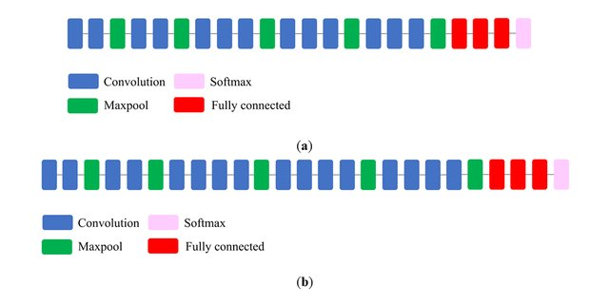
VGG-16, VGG-19

Slide 11
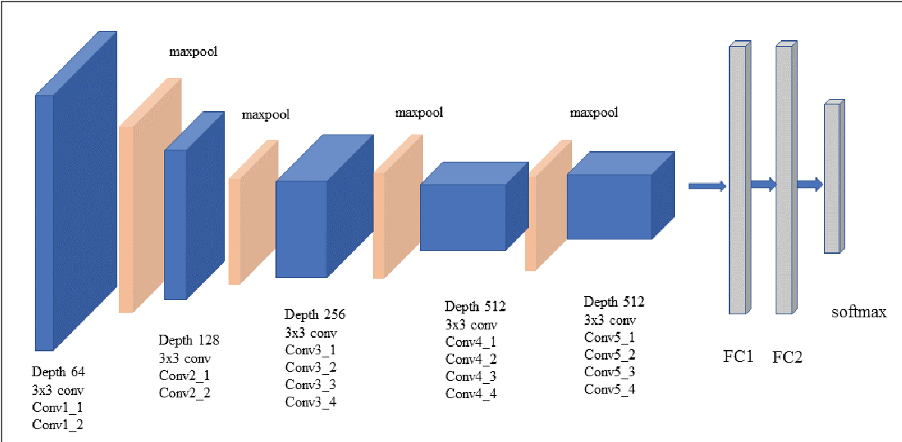
VGG-19

Slide 12
A Neural Algorithm of Artistic Style
Leon A. Gatys, Alexander S. Ecker, Matthias Bethge
In ﬁne art, especially painting, humans have mastered the skill to create unique visual experiences through composing a complex interplay between the content and style of an image
Here we introduce an artiﬁcial system based on a Deep Neural Network that creates artistic images of high perceptual quality

Slide 13
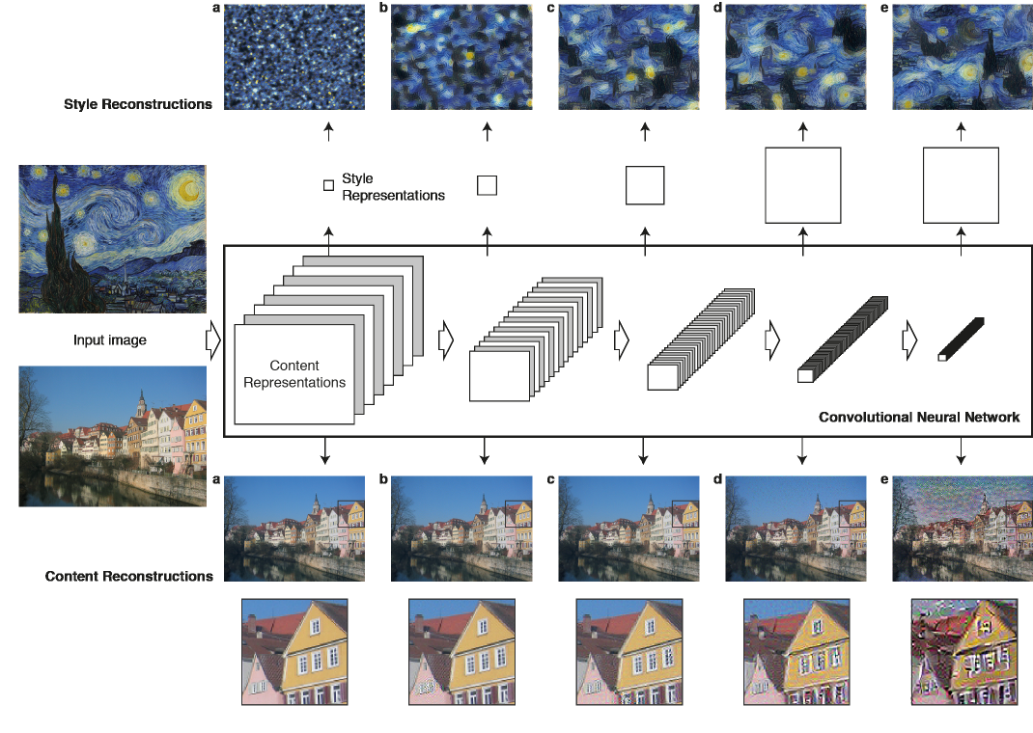

Slide 14

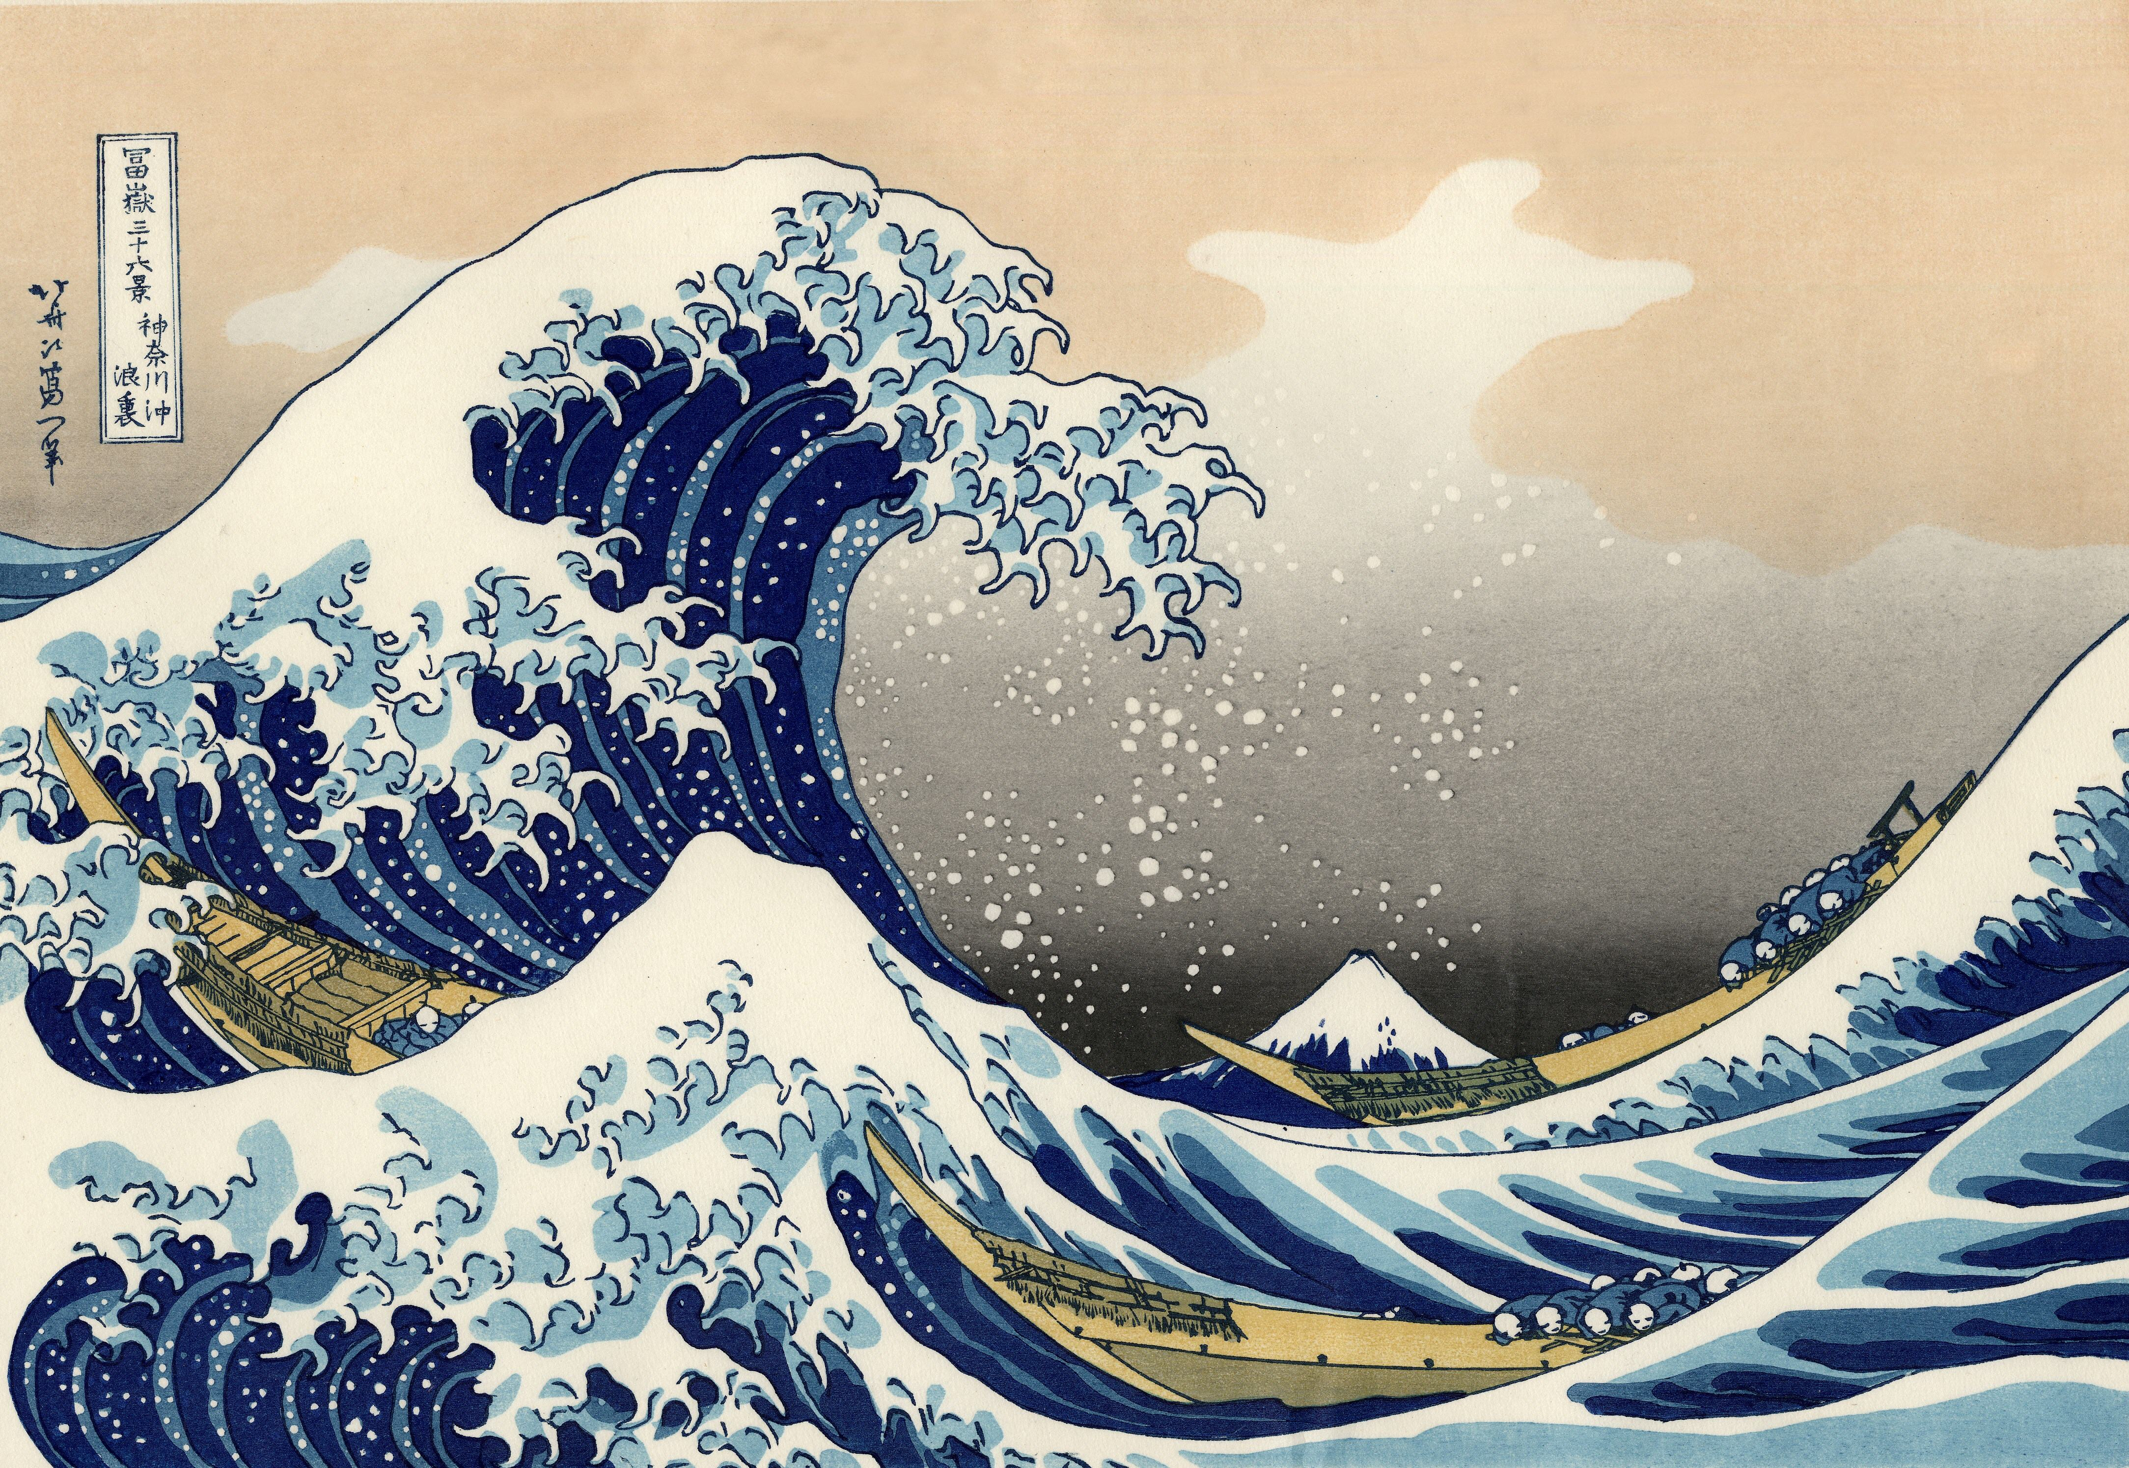
STYLE TRANSFER

Slide 15
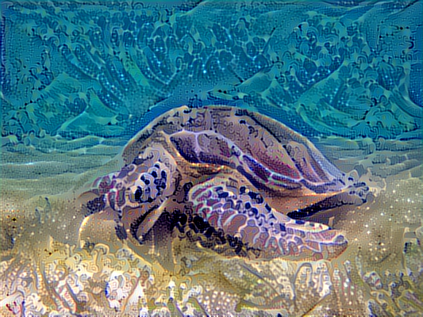

Slide 16
Some other applications
Application of a Novel and Improved VGG-19 Network in the Detection of Workers Wearing Masks
A New Transfer Learning Based on VGG-19 Network for Fault Diagnosis
Fundus Image Classiﬁcation Using VGG-19 Architecture with PCA and SVD
Smartphone-based bulky waste classif ication using convolutional neural networks

